Slide 1
Packaging and Deploying SharePoint Framework Solutions
Notes:
This module examines the process of application lifecycle management (ALM) with SharePoint Framework solutions. The module explains the role of the App Catalog and walks through how to create a new App Catalog site for a SharePoint Online tenant. Students will learn how to bundle and package a SPFX solution for distribution and to optimize SPFX builds for a production environment. The module explains how to package third-party JavaScript libraries as external references and how to deploy SharePoint Framework solution resources to the Office 365 CDN. Students will also learn how to publish SharePoint Framework solution packages in the App Catalog as well as how to install a SPFX solution in a SharePoint site. The module also explains the process of upgrading an SPFX solution after it’s has already been deployed to a production environment.

Slide 2
Agenda
Creating the App Catalog Site in SharePoint Online
Packaging SPFX Solutions for Production
Packaging JavaScript Libraries as External References
Customizing SPFX Builds with Gulp and Webpack
Publishing and Updating SPFX Solutions
Installing an SPFX Solution in a SharePoint Site

Slide 3
Understanding the App Catalog
App publishing scheme based on App Catalog
App Catalog is site collection with special doc library
App packages are published (uploaded) to app catalog
Provides better app discovery, installation and upgrade
App Catalog in on-premises farms
One App Catalog site required for each web application
End users often play role of App Catalog administrator
App Catalog in Office 365 & SharePoint Online
One App Catalog site used to manage entire tenancy
Notes:
Apps can be deployed to a marketplace, either a public “SharePoint Marketplace” where other people can purchase and install your app, just like other marketplaces for smart phones, or using the App Catalog which acts like a private tenant-specific marketplace where apps aren’t bought and sold, rather they are just deployed by corporate developers or when administrators buy licenses and deploy the purchased app to the catalog.

Slide 4
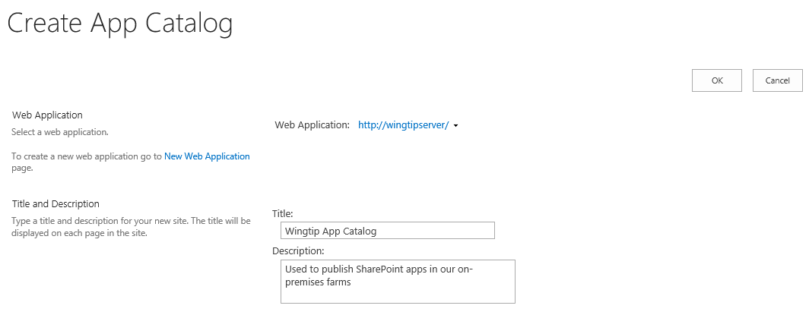
Creating the App Catalog Site Collection
You must create the App Catalog site collection
You can create it using a PowerShell script
You can create it using Central Administration
App Catalog site associated with one web application

Slide 5
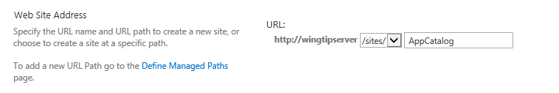
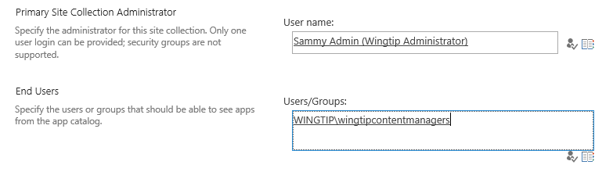
App Catalog URL and Permissions
App catalog site created at a specific URL
Creating App Catalog site with PowerShell is more flexible you can create site as top-level domain using host-named site collections (HNSCs)
Setting App Catalog permissions
Site collection administrator becomes App Catalog administrator
End user permissions allows user to discover and install apps

Slide 6
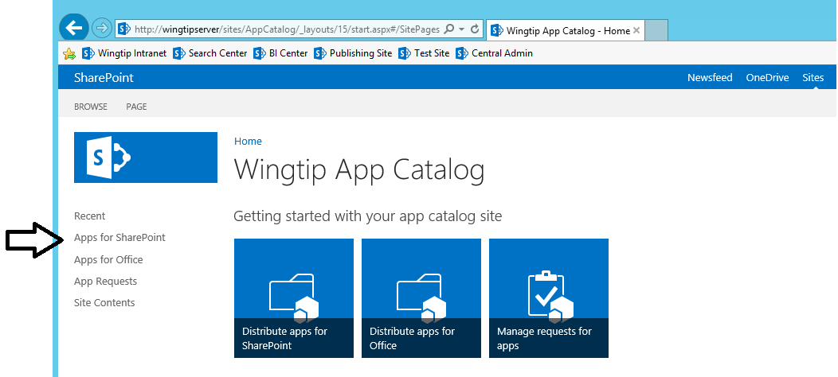
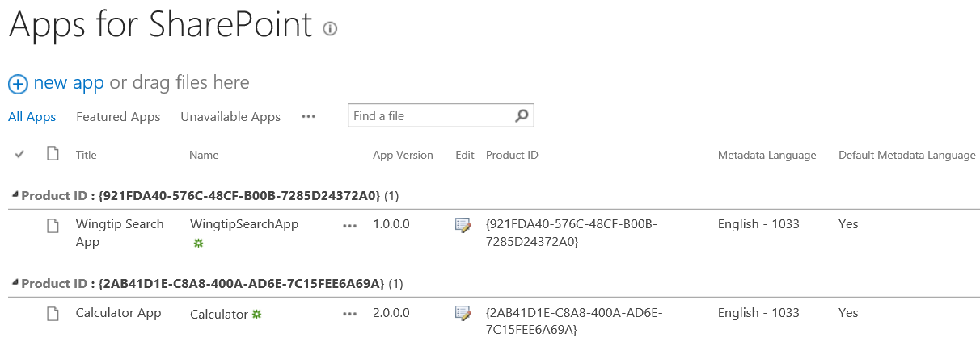
Apps for SharePoint Document Library
Apps for SharePoint is special document library
It's the place where you publish SharePoint apps
You upload app package and enter the related metadata

Slide 7
Creating an App Catalog Site

Slide 8
Agenda
Understanding the SharePoint Online App Catalog
Publishing and Installing SharePoint Add-ins
Packaging SharePoint Framework Projects
Deploying Provider-hosted Add-ins

Slide 9
App Deployment Overview for a SharePoint-hosted App
Package the app
Package app resources in distributable file
Publish the app
Make app available for installation and upgrade
Install the app
Make app available for use
Upgrade the app
Replace current version of app with newer version

Slide 10
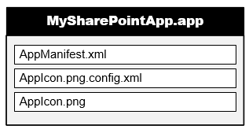
App Package
SharePoint apps distributed using app packages
App package is ZIP archive file with *.app extension
Built according to Open Package Convention (OPC)
Same packaging format used in Apps for Office
App package must contain AppManifest.xml
App package will often contain file for app icon
Notes:
The app package is just a ZIP file that conforms to the Open Package Conventoin (OPC) the same thing used for OpenXML Office files. Within the package you will find the app manifest and likely the app icon.

Slide 11
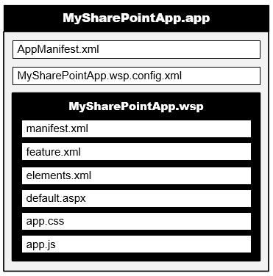
App Web Solution Package
App package contains inner WSP for app web
Elements deployed to app web using solution package
Solution package built into app package as inner WSP
All SharePoint-hosted apps will have an inner WSP in their app package
Cloud-hosted apps will not have an inner WSP in their app package unless they have been implemented to create an app web
Notes:
For SharePoint-Hosted apps, the artifacts that were traditionally deployed with a solution are still included within a WSP that is included within the APP file.

Slide 12
Packaging Host Web Features
Host web feature elements added at top level
elements.xml file added for each app part
elements.xml file added for each UI custom action
features.xml file added for host web feature
Visual Studio adds GUID to file names
Notes:
Host web features are not packaged within a WPS and instead live at the root of the APP package.

Slide 13
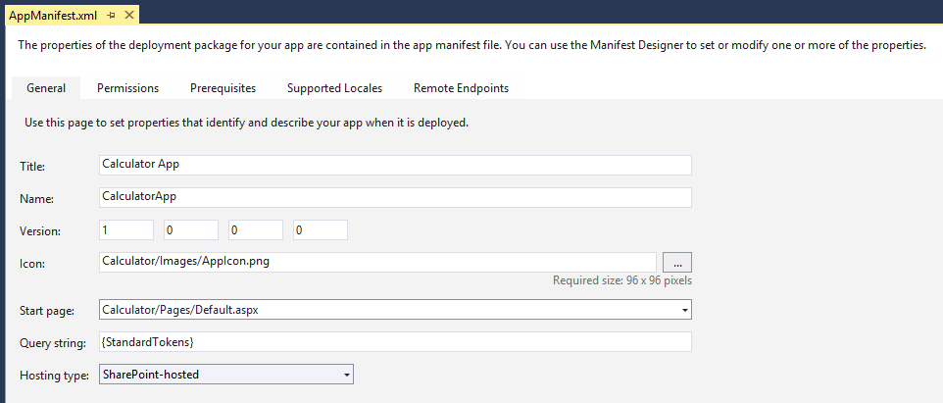
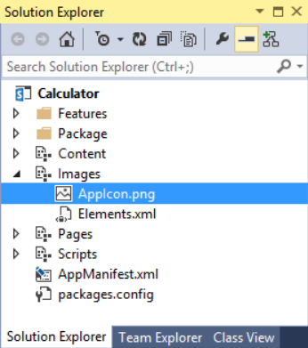
Preparing a Project for Packaging
Review AppManifest.xml and make any required changes
Add a custom App Icon

Slide 14
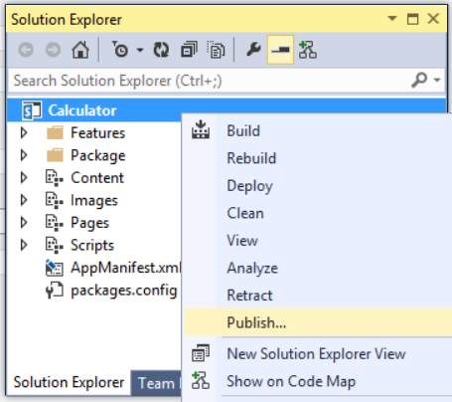
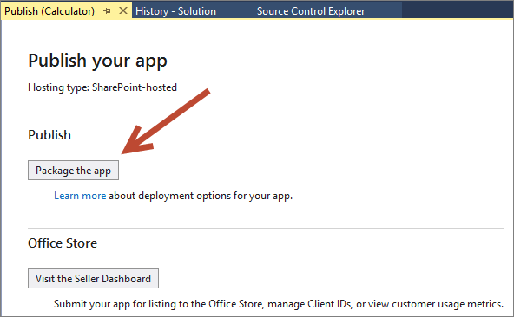
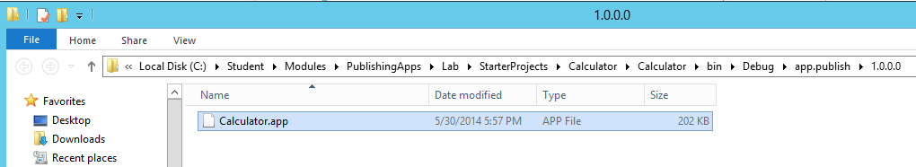
Creating an App Package
1
2
3

Slide 15
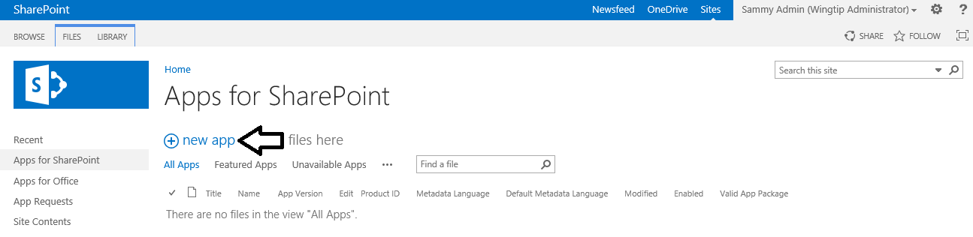
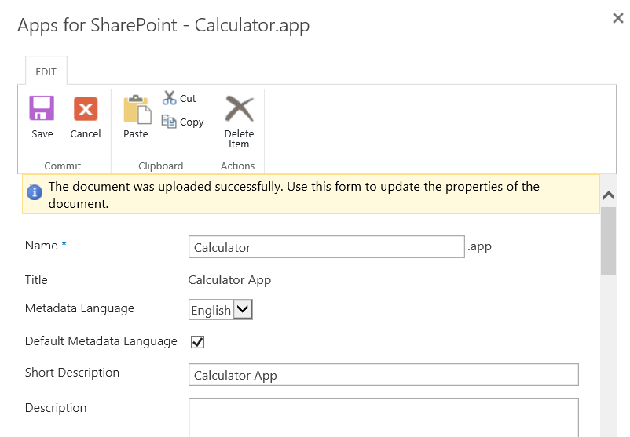
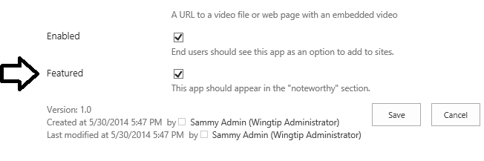
Publishing an App
Upload app package to Apps for SharePoint library
Enter app metadata to complete publishing process

Slide 16
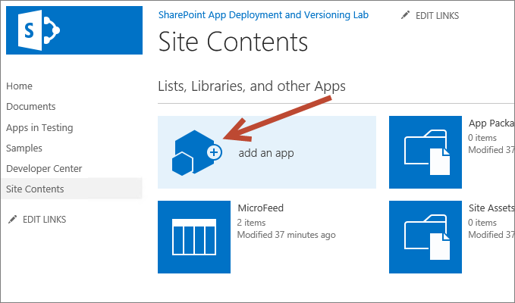
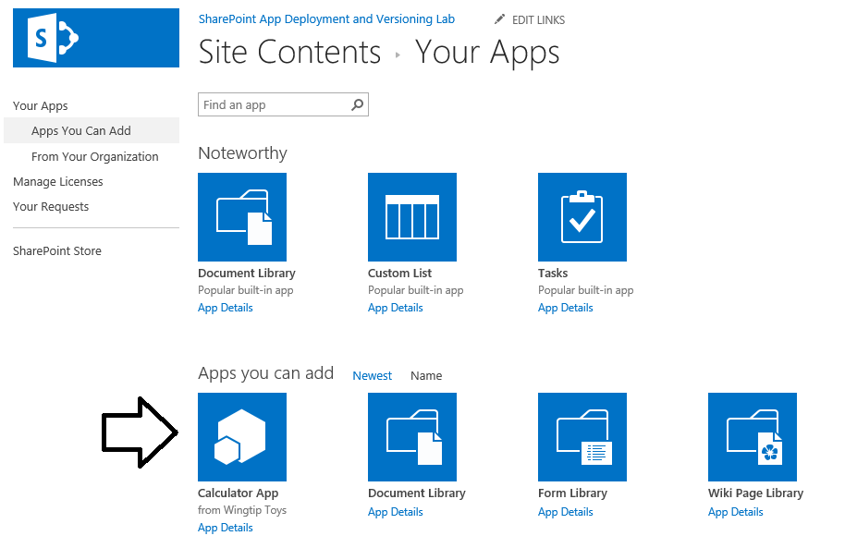
Installing Apps
App installer must be site administrator
Click add an app link on Site Contents page
add an app link takes you to app discovery page (addanapp.aspx)
On Your apps page, click on app tile to install that app
Notes:
Once an app is installed you can see a few things in the action bar about the app.

Slide 17
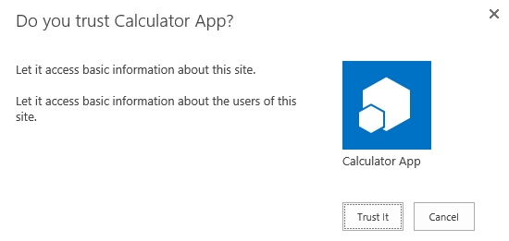
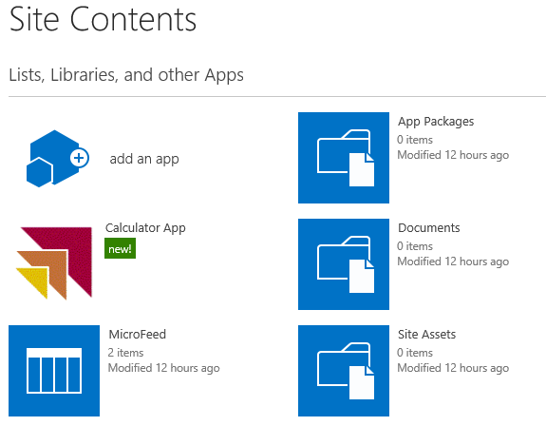
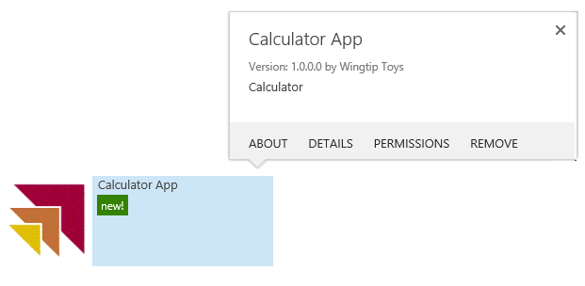
Completing the App installation Process
App installer is Prompted to Explicitly Trust the app During Installation
After installation, app tile added to Site Contents page app tile provides fly-out menu to assist with app management

Slide 18
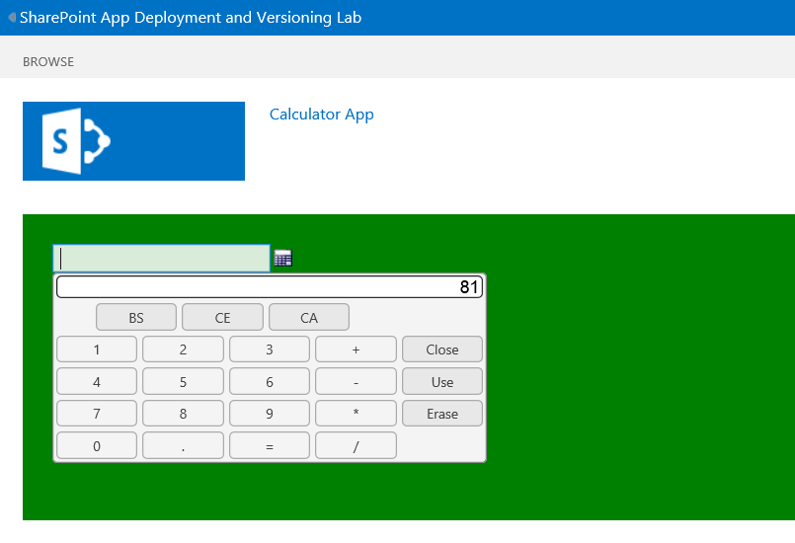
Launching the App After Installation
Clicking app tile on Site Contents page launches app
User is redirected to app start page

Slide 19
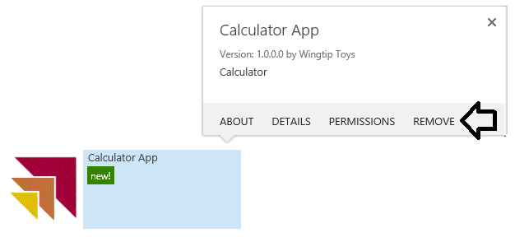
Uninstalling an App
Use Remove command in app tile flyout menu
SharePoint deletes App Web if there is one

Slide 20
Publishing and Installing a SharePoint-hosted App

Slide 21
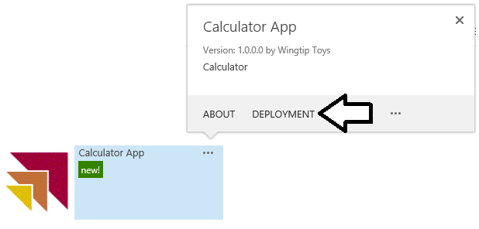
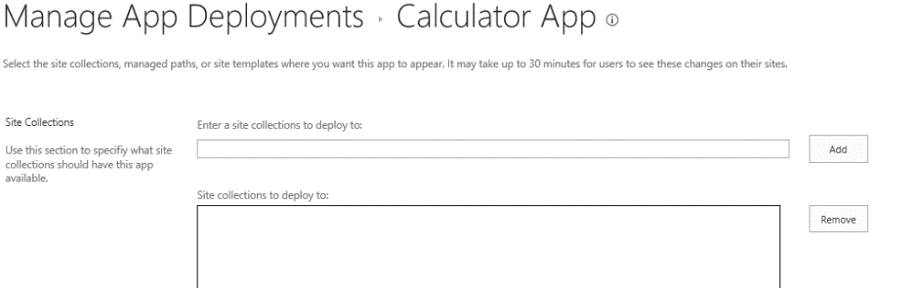
Installing Apps at Tenancy Scope
App catalog site used for tenancy-scoped install
Step 1: Publish app to app catalog site
Step 2: Install app in same app catalog site
Step 3: Configure app to make it available in other sites
Deployment command only appears for apps installed in app catalog sites
Notes:
Apps that are installed at a tenancy scope have an extra “Deployment” link which is used to push the installed app to sites.

Slide 22
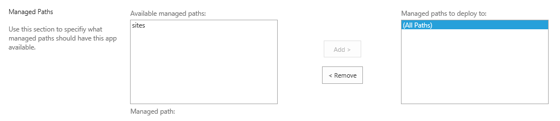
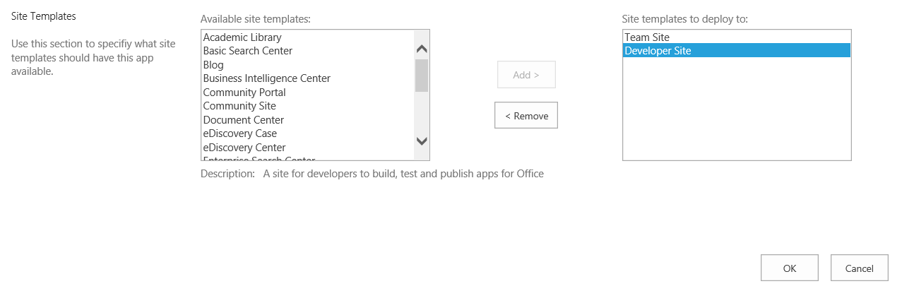
Configuring an App Deployment
App Deployment can be configured in terms of managed paths…
App Deployment can be configured in terms of Site templates…

Slide 23
Installing an App at Tenancy Scope

Slide 24

Upgrading Apps
Overview of SharePoint app upgrade process
App catalog tracks current version number of app
SharePoint host records app version at install time
Updated version of app can be uploaded to app catalog
SharePoint host notifies user when there's new version
User makes choice whether upgrade or not
User (app installer) is never forced to upgrade
If user decides to upgrade, upgrade involves clicking button
Notes:
App updates are not automatically pushed out to every place it is installed. Just like smart phones, users are notified the app has an update available. This means that even though developers may publish a new version, they could have many previous versions of the app running at any given time.

Slide 25
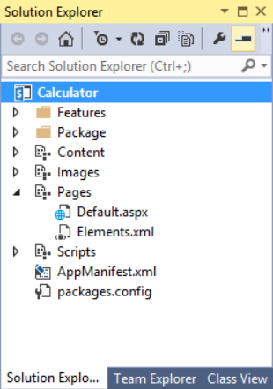
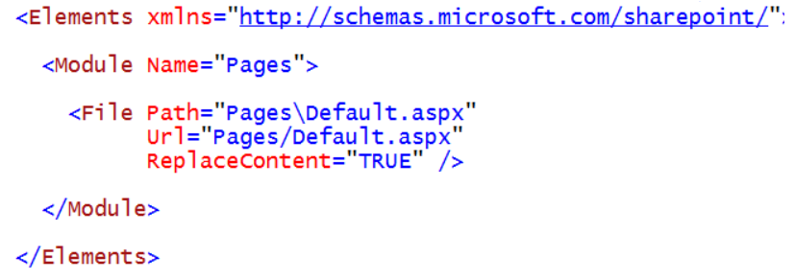
Overwriting Existing Files During Upgrade
Files to be upgrade required ReplaceContent attribute
Edit must be made by hand to Elements.xml file

Slide 26
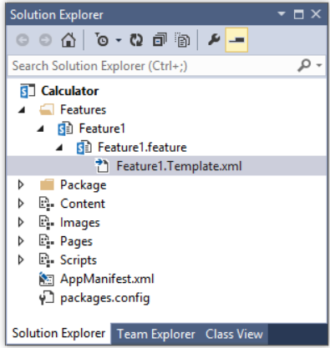
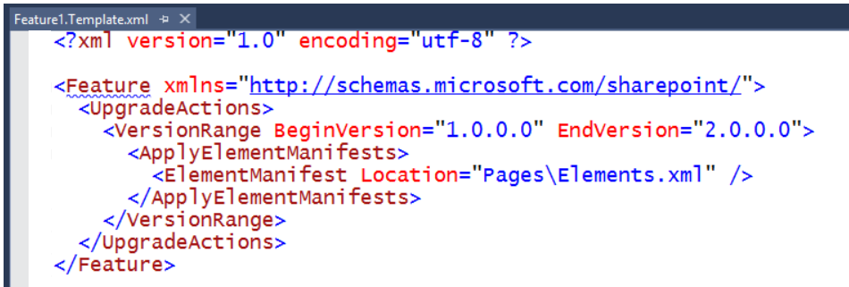
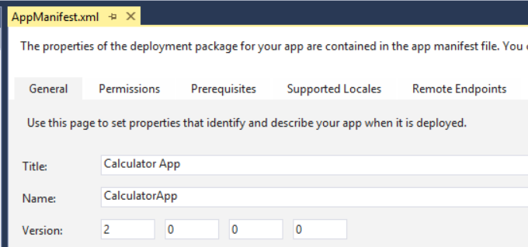
Configuring Feature Upgrade Actions
Upgrade actions must be entered by hand
Make sure to update version number in AppManifest.xml

Slide 27
Upgrading the Start Page of a SharePoint-hosted App

Slide 28
Agenda
Understanding the SharePoint Online App Catalog
Publishing and Installing SharePoint Add-ins
Packaging SharePoint Framework Projects
Deploying Provider-hosted Add-ins

Slide 29
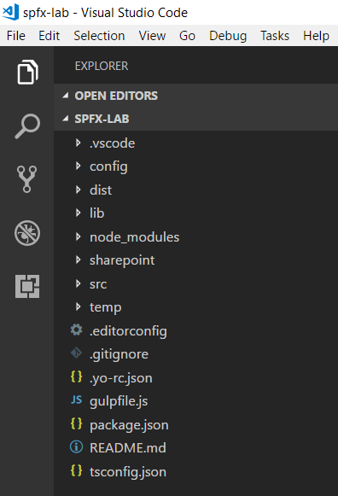
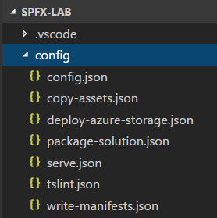
SPFx Project Configuration Files

Slide 30
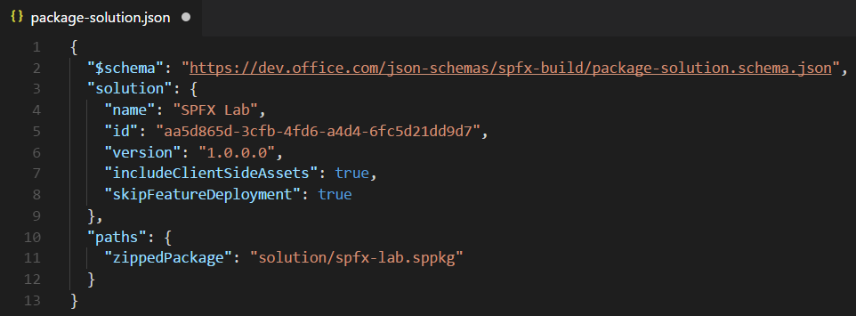
package-solution.json
package-solution.json
Contains top-level project properties (id, name, version)
includeClientSideAssets
skipFeatureDeployment
zippedPackage

Slide 31
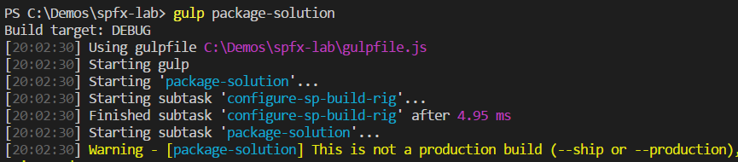
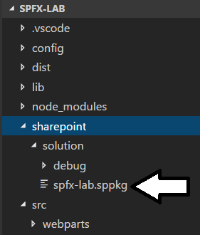
Building a SPFx Solution
Done by executing gulp package-solution
Can be done with or without --ship parameter
Generates zip archive with .sppkg extension

Slide 32
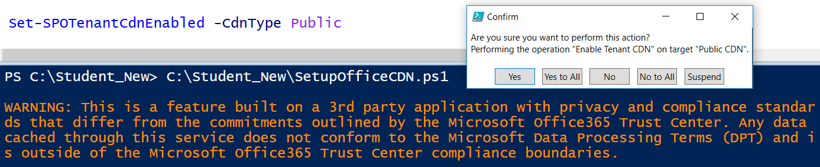
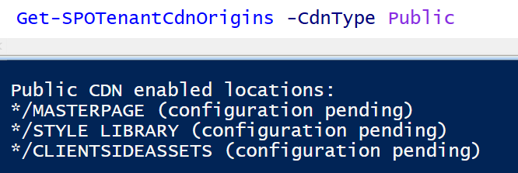
Enabling the Office 365 CDN
Office 365 provides CDN for SPFx solution deployment
Office 365 CDN must be enabled using PowerShell
Enabling CDN creates */CLIENTSIDEASSETS origin
CDN supports these file type extensions CSS, EOT, GIF, ICO, JPEG, JPG, JS, MAP, PNG, SVG, TTF, WOFF

Slide 33
includeClientSideAssets = True
If Office 365 CDN is enabled…
it will be used automatically with default settings.
If Office 365 CDN is not enabled…
assets will be served from app catalog site collection.

Slide 34
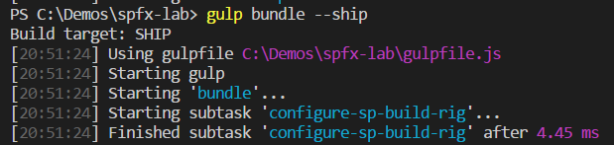
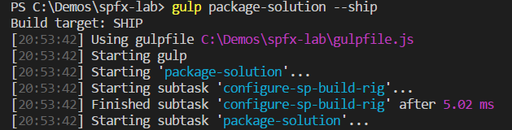
Packaging a SPFx Solution for Distribution
gulp bundle --ship
Uses dynamic URL for assets based on tenant CDN settings
gulp package-solution --ship
Uses dynamic URL for assets based on tenant CDN settings

Slide 35
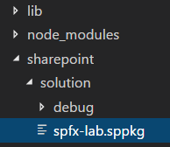
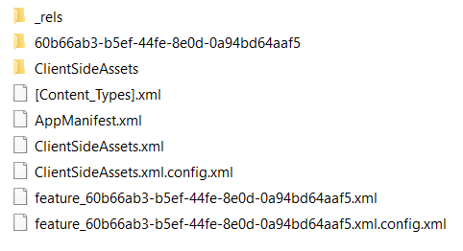
Inside a SPFx Solution Package
Your .js code is included in ClientSideAssets

Slide 36
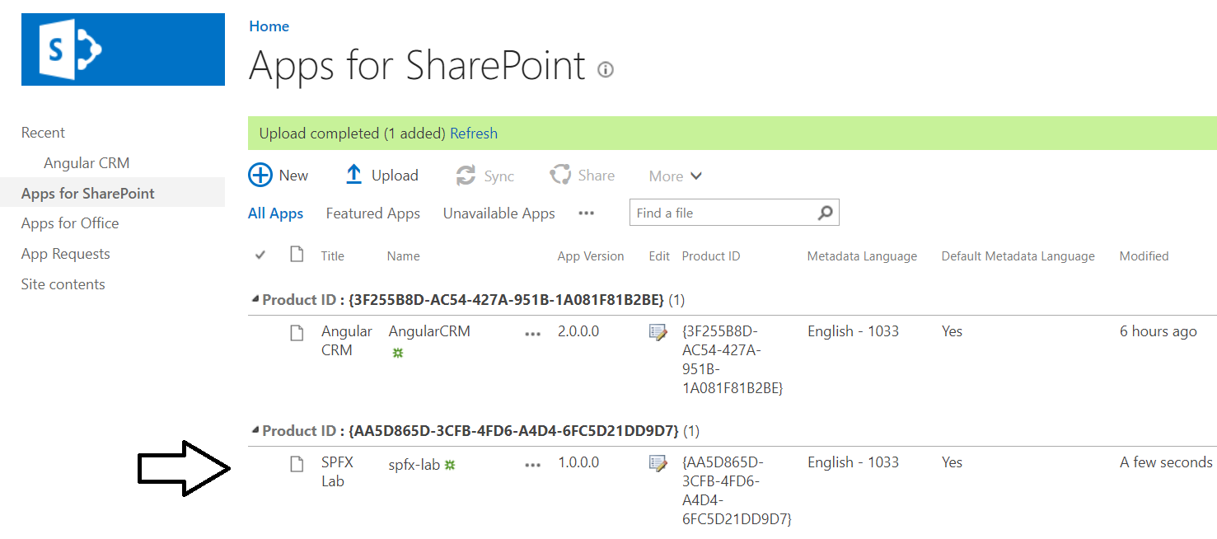
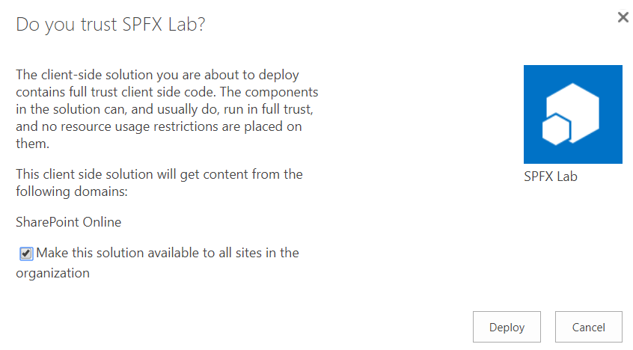
Deploying Solution to Office 365 Tenancy

Slide 37
Agenda
Understanding the SharePoint Online App Catalog
Publishing and Installing SharePoint Add-ins
Packaging SharePoint Framework Projects
Deploying Provider-hosted Add-ins

Slide 38
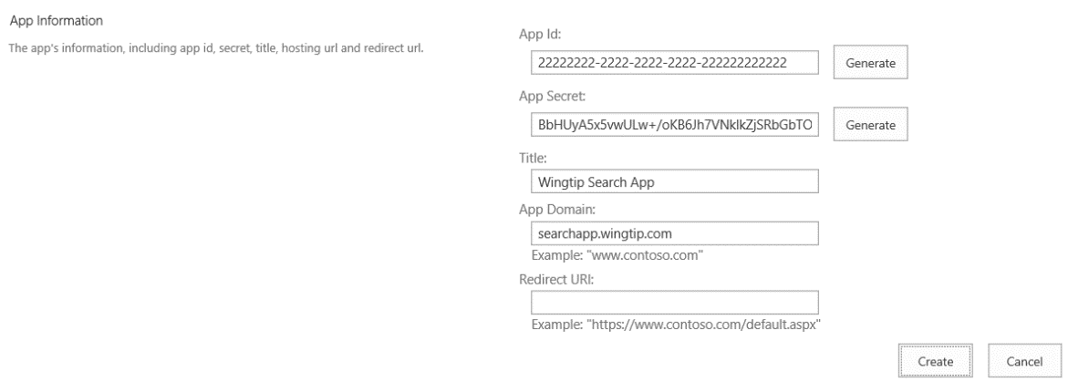
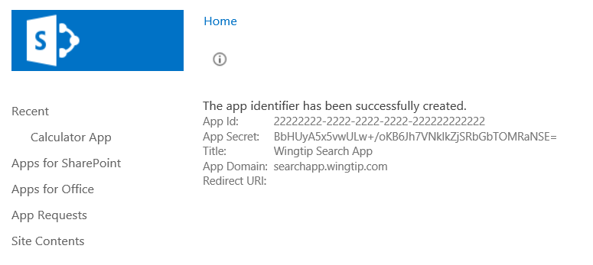
Registering the App Security Principal
Can be done manually using AppRegNew.aspx page
Enter the App ID (aka Client ID)
Enter an App Secret (even in S2S scenario when it is not used)
Enter a Title
Enter an App Domain

Slide 39
Registering the App Security Principal for a Provider-hosted App

Slide 40
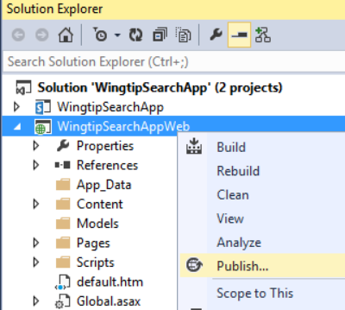
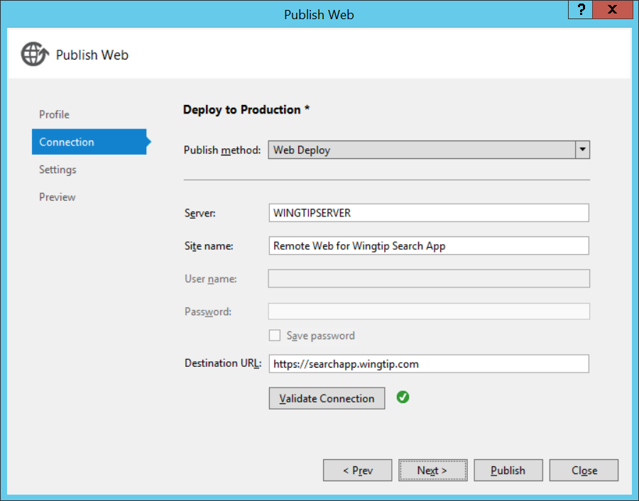
Deploying the App's Remote Web Project
Visual Studio provides Publish Web wizard
Allows you to create one or more deployment configurations
Automatically pushes Web Project files into IIS website

Slide 41
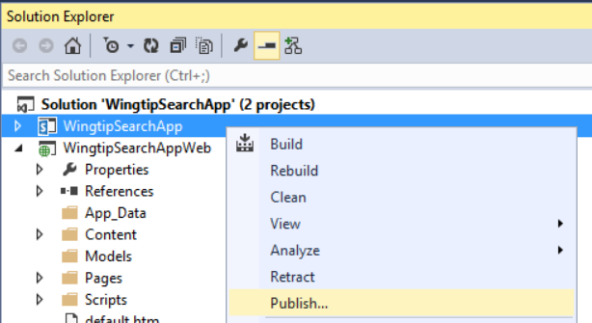
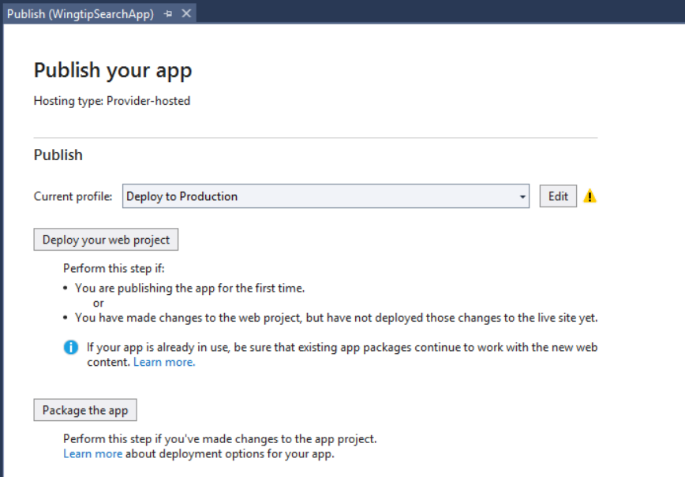
Creating the Provider-hosted App Package
Visual Studio provides Publish your app page
Click Package the app to begin packaging process

Slide 42


Enter Information for the App Package
Provide-hosted App must be published with…
SSL-based URL where the remote web has been deployed
The App ID (aka Client ID)

Slide 43


Publishing and Installing the App
Publish the app package (just like with a SharePoint-hosted app)
Install and launch

Slide 44
Deploying a Provider-hosted App in an Office 365 using Windows Azure

Slide 45
Summary
Understanding the SharePoint Online App Catalog
Publishing and Installing SharePoint Add-ins
Packaging SharePoint Framework Projects
Deploying Provider-hosted Add-ins

